Slide 1
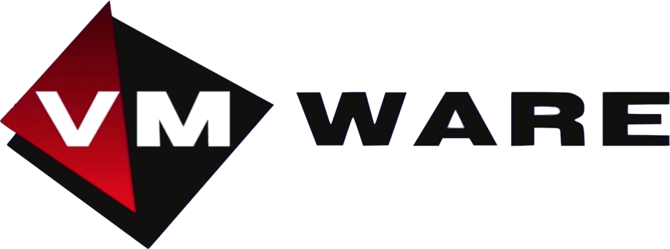
CS518- Group Presentation
Ramya, Riley, Ryan

Slide 2
What is Virtualization?
In order to understand the VMware vCenter Server, it’s important to first understand virtualization
Virtualization: a way for companies to rely on cloud-based software that imitates physical servers
Creates a virtual server system
Can host multiple servers on one machine

Slide 3
So, What is VSphere?
VMware vSphere is the name of VMware’s server virtualization product
Server virtualization: allows multiple servers to work on one machine, instead of just one machine per server

Slide 4
What is VMware vCenter Server?
Provides centralized management of vSphere virtual infrastructure
Control and manage multiple vSphere-based servers from a single console
Offers centralized platform for managing virtual infrastructure

Slide 5
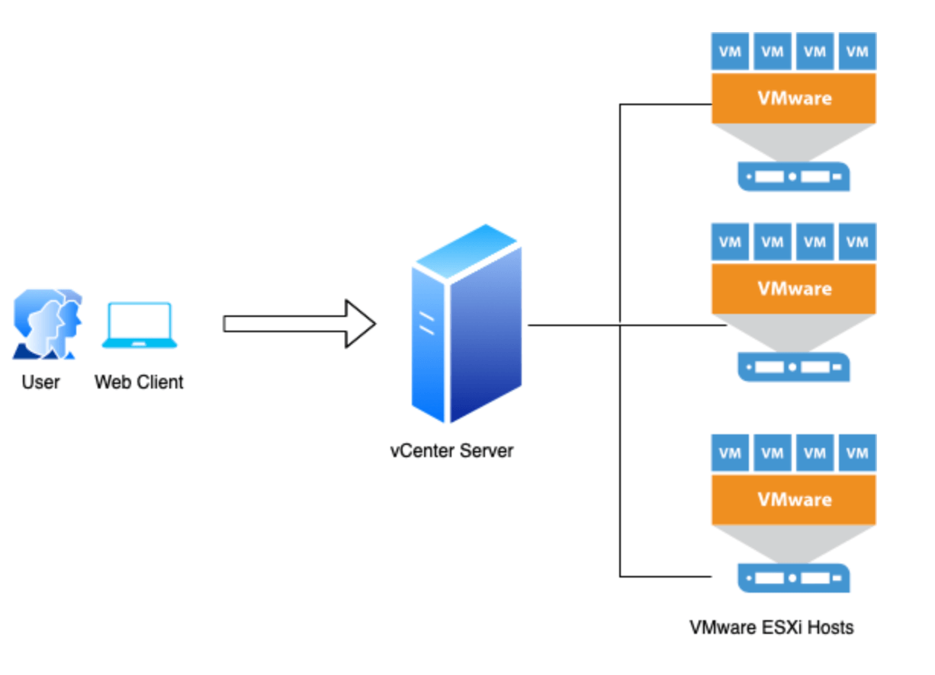

Slide 6




Who
More than 400,000 customers
Amazon (Shopping)
Adobe (Software)
AT&T (Phone services)
Honda (Cars)

Slide 7
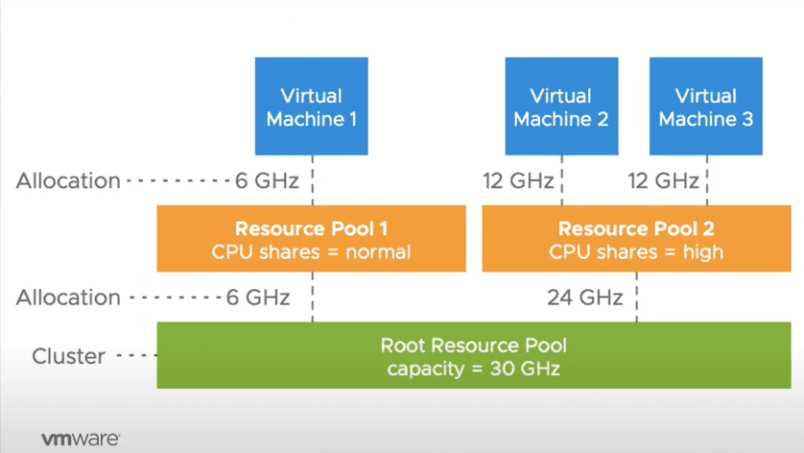

Why
Centralized Management/Visibility
Automation
IaaS
Private Cloud
Security

Slide 8
Sources
https://www.vmware.com/files/pdf/VMware-Corporate-Brochure-BR-EN.pdf
https://www.featuredcustomers.com/vendor/vmware/customers
https://www.newhorizons.com/resources/d/blog/what-is-vsphere-an-introduction-to-vmwares-virtualization-platform

